Slide 1
Implementation of ILS Localizer Receiver using SDR
Aditya Saggar
Sardar Vallabhbhai National Institute of Technology

Slide 2
Objectives
Understand the fundamentals of Software Defined Radio
Learn about Instrument Landing Systems
Realize the need for SDR Receivers for ILS Systems
Discuss ILS Localizers in depth
Analyse different receiver setups
Demonstrate Receiver Setup
Discuss the future roadmap for this project

Slide 3
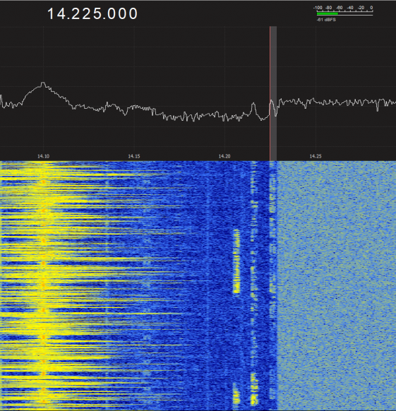
Software Defined Radio
Software Defined Radios refer to communication systems in which some of the physical layer functions are defined in software.
What are the benefits?
What are the use cases?
.

Slide 4
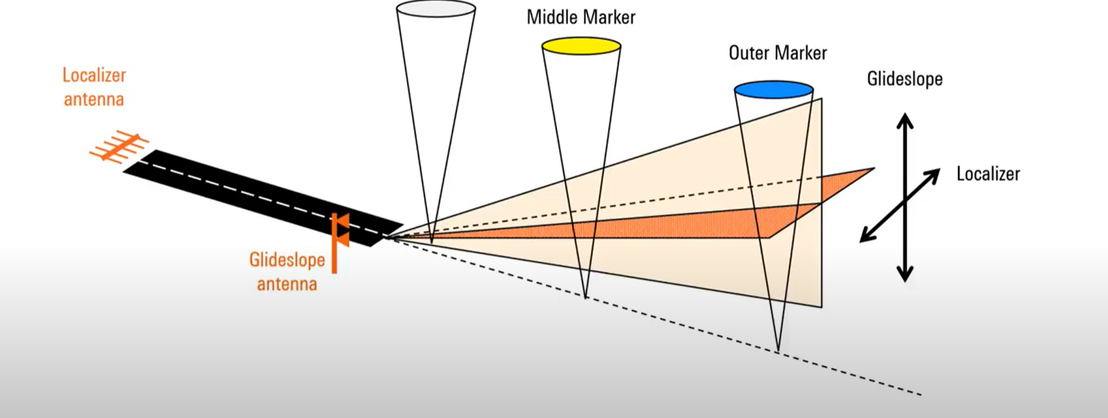
A Brief Overview of Instrument Landing Systems
Why use the Instrument Landing System?
Components :
Localiser
Glideslope
Marker Beacons
What is the working principle?

Slide 5
Need for Software Defined ILS Receivers
Radio signal transmitters need routine signal inspections.
This routine check is carried out by flight inspection using a specially fitted aircraft
Testing can instead be performed by a UAV

Slide 6
Instrument Landing System: Localizer
Localizer emits 90 Hz and 150 Hz tones, amplitude modulated
Modulation Depth: between 0 and 0.2 for both tones.
Carrier Signal: 108.10-111.95 MHz [40 ch]

Slide 7
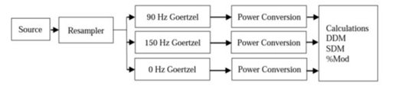
Problem Statement: How can we design a ILS localizer receiver in software?
Using GNURadio- Open Source SDR software: Modular, Flowgraph oriented
ILS Signal parameters –
Sum of Depth of Modulation (Always 0.4)
Difference of Depth of Modulation (0.0-0.4)
Discrete Frequency Domain Implementation
Discrete Frequency Domain Approach
[Leosrisook, Chanan,An implementation of portable ILS Localizer signal receiver using SDR.IEEE, 2014.]

Slide 8
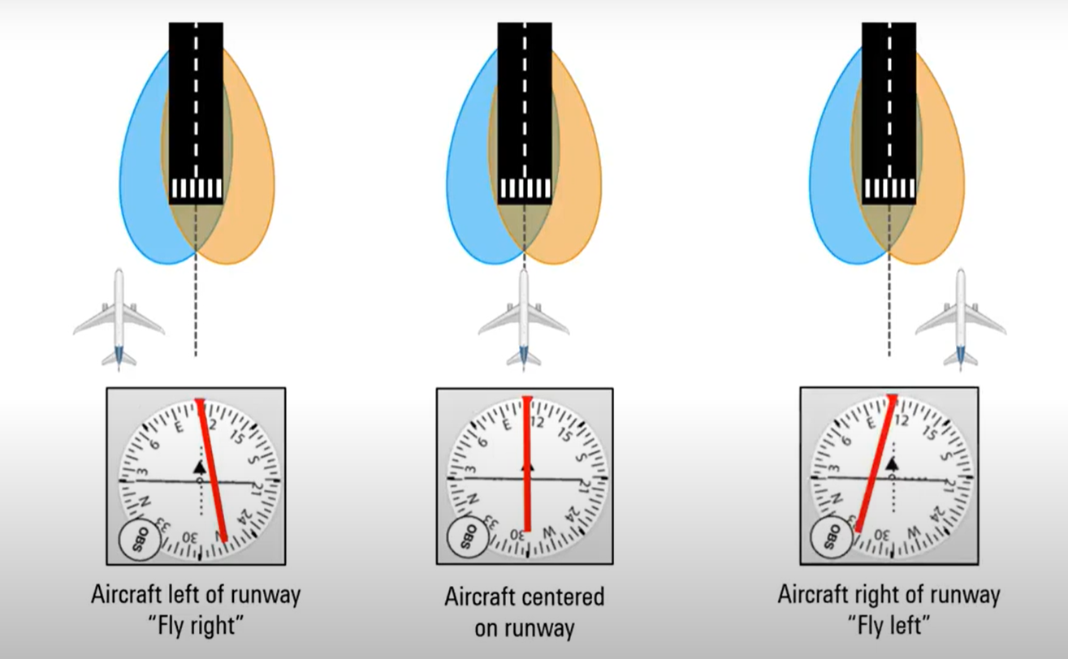
Three Different Test Scenarios
[Rhode & Schwarz]

Slide 9

Future Roadmap
Analysis with Real Data
Connection with USRP Hardware for Off the Air Signal Analysis
Run program on FPGA for real time mobile analysis

